Slide 1
Welcome to DSO401T

Slide 2
Personalia
Lecturer | Emmanuel Ramafalo
Company | Eskom
Current position | Manager: Information Systems
WhatsApp | 083 330 8467
Email | ramafalome1@gmail.com

Slide 3
PL/SQL
Introduction
Structure of a block
Variables and types
Accessing the database
Control flow
Cursors
Exceptions
Procedures and functions

Slide 4
Introduction
PL/SQL stands for Procedural Language/SQL.
PL/SQL extends SQL by adding constructs found in procedural languages, resulting in a structural language that is more powerful than SQL.
The basic unit in PL/SQL is a block. All PL/SQL programs are made up of blocks, which can be nested within each other. Typically, each block performs a logical action in the program.

Slide 5
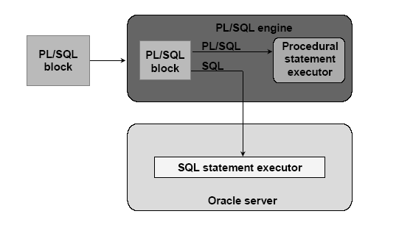
PL/SQL Environment

Slide 6
Benefits
Integrate of database technology and procedural programming capabilities
Provide improved performance of an application
Modularize program development
Portable among host environments supporting Oracle server and PL/SQL
Handle errors

Slide 7
Structure of a block
DECLARE
/* Declarative section: variables, types, cursors, user-defined exceptions */
BEGIN
/* Executable section: procedural and SQL statements go here. */
/* This is the only section of the block that is required. */
EXCEPTION
/* Exception handling section: error handling statements go here. */
END; /* mandatory */

Slide 8
Block (1)
The only SQL statements allowed in a PL/SQL program are SELECT, INSERT, UPDATE, DELETE and several other data manipulation statements plus some transaction control.
Data definition statements like CREATE, DROP, or ALTER are not allowed.
The executable section also contains constructs such as assignments, branches, loops, procedure calls, and triggers

Slide 9
Block (2)
PL/SQL is not case sensitive. C style comments (/* ... */) may be used.
To execute a PL/SQL program, we must follow the program text itself by: a line with a single dot ("."), and then a line with “run”; or a line with “/”
We can invoke a PL/SQL program either by typing it in sqlplus or by putting the code in a file and invoking the file

Slide 10
Variables and Types (1)
Information is transmitted between a PL/SQL program and the database through variables.
Every variable has a specific type associated with it, that can be:
One of the types used by SQL for database columns
A generic type used in PL/SQL such as NUMBER
Declared to be the same as the type of some database column

Slide 11
Variables and Types (2)
The most commonly used generic type is NUMBER. Variables of type NUMBER can hold either an integer or a real number.
The most commonly used character string type is VARCHAR(n), where n is the maximum length of the string in bytes. This length is required, and there is no default.

Slide 12
Example
DECLARE
price NUMBER;
myBeer VARCHAR(20);

Slide 13
Declaring Boolean variables
Only the values TRUE, FALSE, and NULL can be assigned to a Boolean variable.
• The variables are compared by the logical
operators AND, OR, and NOT.
• The variables always yield TRUE, FALSE, or NULL.
• Arithmetic, character, and date expressions can be used to return a Boolean value.

Slide 14
Example
DECLARE
v_flag BOOLEAN := FALSE;
BEGIN
v_flag := TRUE;
END;

Slide 15
The %TYPE attribute
A PL/SQL variable can be used to manipulate data stored in a existing relation.
The variable must have the same type as the relation column. If there is any type mismatch, variable assignments and comparisons may not work the way you expect.
To be safe, instead of hard coding the type of a variable, you should use the %TYPE operator.
Ex:
DECLARE myBeer Beers.name%TYPE;
gives PL/SQL variable myBeer whatever type was declared for the name column in relation Beers.

Slide 16
The %ROWTYPE attribute
A variable may also have a type that is a record with several fields.
The simplest way to declare such a variable is to use %ROWTYPE on a relation name. The result is a record type in which the fields have the same names and types as the attributes of the relation.
Ex:
DECLARE beerTuple Beers%ROWTYPE;
makes variable beerTuple be a record with fields name and manufacture, assuming that the relation has the schema Beers(name, manufacture).

Slide 17
Default values and assignments
The initial value of any variable, regardless of its type, is NULL.
We can assign values to variables, using the ":=" operator.
The assignment can occur either immediately after the type of the variable is declared, or anywhere in the executable portion of the program.
Ex:
DECLARE
a NUMBER := 3;
BEGIN
a := a + 1;
END;
.
run;

Slide 18
Bind variables
Variable that you declare in a host environment (ex: SQL*Plus), used to pass run-time values (number or characters) into or out of PL/SQL programs
The only kind that may be printed with a print command.
Bind variables must be prefixed with a colon in PL/SQL statements

Slide 19
Steps to create a bind variable
We declare a bind variable as follows: VARIABLE <name> <type> where the type can be only one of three things: NUMBER, CHAR, or CHAR(n).
We may then assign to the variable in a following PL/SQL statement, but we must prefix it with a colon.
Finally, we can execute a statement :
PRINT :<name>;
outside the PL/SQL statement

Slide 20
Example
VARIABLE
x NUMBER
BEGIN
:x := 1;
END;
.
run;
PRINT :x;

Slide 21
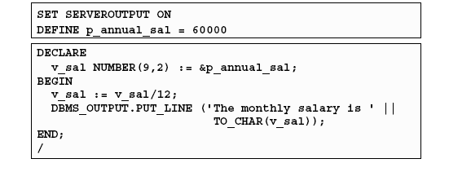
DBMS_OUTPUT.PUT_LINE package
An Oracle-supplied packaged procedure
An alternative for displaying data from a PL/SQL block
Must be enabled in SQL*Plus with: SET SERVEROUTPUT ON

Slide 22
Simple programs accessing the database
The simplest form of program has some declarations followed by an executable section consisting of one or more of the SQL statements with which we are familiar.
After the SELECT clause, we must have an INTO clause listing variables, one for each attribute in the SELECT clause, into which the components of the retrieved tuple must be placed.
The SELECT statement in PL/SQL only works if the result of the query contains a single tuple. If the query returns more than one tuple, you need to use a cursor

Slide 23
Example (SQL)
CREATE TABLE T1(
e INTEGER,
f INTEGER );
DELETE FROM T1;
INSERT INTO T1 VALUES(1, 3);
INSERT INTO T1 VALUES(2, 4);

Slide 24
Example (PL/SQL)
DECLARE
a NUMBER;
b NUMBER;
BEGIN
SELECT e,f INTO a,b FROM T1 WHERE e>1;
INSERT INTO T1 VALUES(b,a);
END;
.
run;

Slide 25
Control flow
PL/SQL allows you to branch and create loops in a fairly familiar way.
An IF statement looks like:
IF <condition> THEN <statement_list>
ELSE <statement_list>
END IF;
The ELSE part is optional. If you want a multiway branch, use:
IF <condition_1> THEN ...
ELSIF <condition_2> THEN ... ... ...
ELSIF <condition_n> THEN ...
ELSE ...
END IF;

Slide 26
Example
DECLARE
a NUMBER;
b NUMBER;
BEGIN
SELECT e,f INTO a,b FROM T1 WHERE e>1;
IF b=1 THEN
INSERT INTO T1 VALUES (b,a);
ELSE
INSERT INTO T1 VALUES (b+10,a+10);
END IF;
END;
.
run;

Slide 27
Loops
Loops are created with the following:
LOOP
<loop_body> /* A list of statements. */
END LOOP;
At least one of the statements in <loop_body> should be an EXIT statement of the form
EXIT WHEN <condition>;
The loop breaks if <condition> is true.

Slide 28
Example
DECLARE
i NUMBER := 1;
BEGIN
LOOP
INSERT INTO T1 VALUES (i,i);
i := i+1;
EXIT WHEN i>100;
END LOOP;
END;
.
run;

Slide 29
Other useful loop-forming statements
A WHILE loop can be formed with:
WHILE <condition> LOOP
<loop_body>
END LOOP;
A simple FOR loop can be formed with:
FOR <var> IN <start>..<finish> LOOP
<loop_body>
END LOOP;
Here, <var> can be any variable; it is local to the for-loop and need not be declared. Also, <start> and <finish> are constants.

Slide 30
Cursors
A cursor is a variable that runs through the tuples of some relation.
Can be a stored table or the answer to some query.
By fetching into the cursor each tuple of the relation, we can write a program to read and process the value of each such tuple.
If the relation is stored, we can also update or delete the tuple at the current cursor position.

Slide 31
Example (1)
Uses T1(e,f) whose tuples are pairs of integers.
The program will delete every tuple whose first component is less than the second, and insert the reverse tuple into T1.

Slide 32
Example (2)
DECLARE
/* Output variables to hold the result of the query: */
a T1.e%TYPE;
b T1.f%TYPE;
/* Cursor declaration: */
CURSOR T1Cursor IS
SELECT e, f FROM T1 WHERE e < f
FOR UPDATE;
BEGIN
OPEN T1Cursor;
LOOP /* Retrieve each row of the result of the above query into PL/SQL variables: */
FETCH T1Cursor INTO a, b;
/* If there are no more rows to fetch, exit the loop: */
EXIT WHEN T1Cursor%NOTFOUND;
/* Delete the current tuple: */
DELETE FROM T1 WHERE CURRENT OF T1Cursor;
/* Insert the reverse tuple: */
INSERT INTO T1 VALUES(b, a);
END LOOP;
/* Free cursor used by the query. */
CLOSE T1Cursor;
END;

Slide 33
Exceptions
An exception is an identifier in PL/SQL that is raised during execution.
• How is it raised?
– An Oracle error occurs.
– You raise it explicitly.
• How do you handle it?
– Trap it with a handler.
– Propagate it to the calling environment.

Slide 34
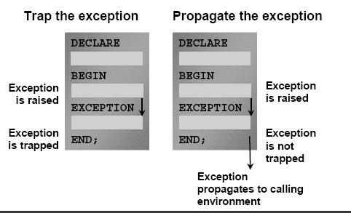
Handling exceptions

Slide 35
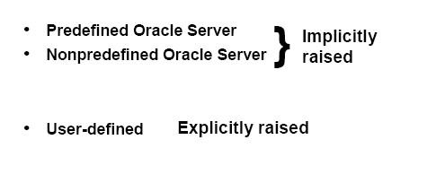
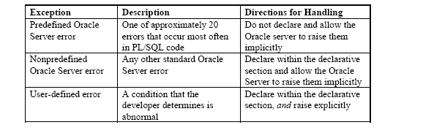
Exception types

Slide 36
Trapping exceptions
Syntax:
EXCEPTION
WHEN exception1 [OR exception2 . . .] THEN
statement1; /* one or more PL/SQL or SQL statements */
statement2;
. . .
[WHEN exception3 [OR exception4 . . .] THEN
statement1;
statement2;
. . .]
[WHEN OTHERS THEN
statement1;
statement2;
. . .]
Only one handler is processed
WHEN OTHERS is unique and must be the last handler

Slide 37
Trapping pre-defined Oracle server errors
Reference the standard name in the exception handling routine.
• Sample predefined exceptions:
– NO_DATA_FOUND
– TOO_MANY_ROWS
– INVALID_CURSOR
– ZERO_DIVIDE
– DUP_VAL_ON_INDEX

Slide 38
Functions for Trapping Exceptions
When an exception occurs, you can identify the associated error code or error message by using two functions.
Based on the values of the code or message, you can decide which subsequent action to take based on the error.
SQLCODE: Returns the numeric value for the error code
SQLERRM: Returns the message associated with the error number
Examples of SQLCODE values:
0: no exception encountered
1: user-defined exception
+100: NO_DATA_FOUND_EXCEPTION
Negative number: another Oracle server error number

Slide 39
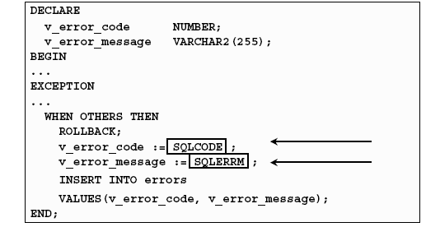
Example

Slide 40
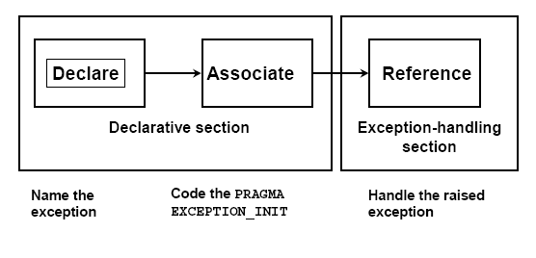
Trapping Nonpredefined Oracle Server Errors
Notes:
Pragma (pseudo instructions) is the keyword that means that the statement is a compiler directive, which is not processed when the PL/SQL block is executed.
It directs the compiler to interpret all occurrences of the exception name within the block as the associated Oracle server error number.

Slide 41
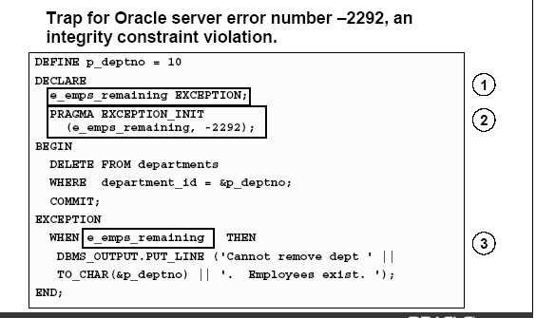
Example

Slide 42
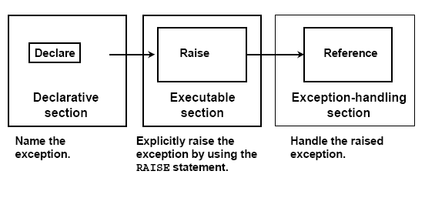
Trapping User-Defined Exceptions

Slide 43
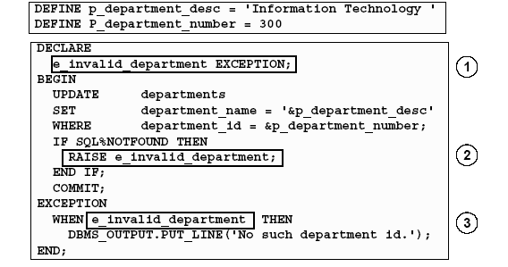
Example

Slide 44
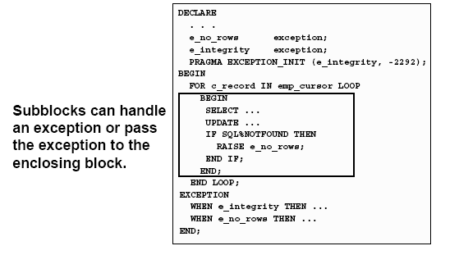
Propagating exceptions

Slide 45
RAISE_APPLICATION_ERROR Procedure
Syntax:
raise_application_error (error_number,
message[, {TRUE | FALSE}]);
• You can use this procedure to issue user-error messages from stored subprograms.
• You can report errors to your application and avoid returning unhandled exceptions.
Used in two different places:
– Executable section
– Exception section
• Returns error conditions to the user in a manner consistent with other Oracle server errors

Slide 46
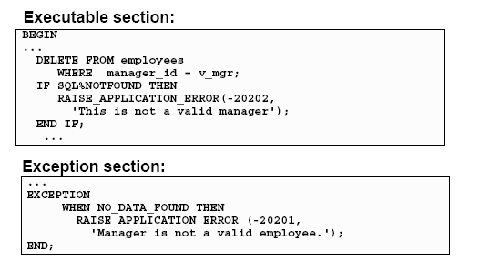
Example

Slide 47
Procedures (1)
Behave very much like procedures in other programming language
A procedure is introduced by the keywords CREATE PROCEDURE followed by the procedure name and its parameters.
CREATE may be followed by OR REPLACE.
If the procedure is already created, we will not get an error
If the previous definition is a different procedure with the same name, the old procedure will be lost.

Slide 48
Procedures(2)
Can have any number of parameters, each followed by a mode and a type. The possible modes are:
IN (read-only), OUT (write-only), and INOUT (read+write).
The type specifier in a parameter declaration must be unconstrained
CHAR(10) and VARCHAR(20) are illegal; CHAR or VARCHAR should be used instead. The actual length of a parameter depends on the corresponding argument that is passed in when the procedure is invoked.
Following the arguments is the keyword AS (IS is a synonym). Then comes the body, which is essentially a PL/SQL block.
The DECLARE section should not start with the keyword DECLARE. Rather, following AS we have:
... AS <local_var_declarations> BEGIN <procedure_body> END; /

Slide 49
Example
Addtuple1: given an integer i, inserts the tuple (i, 'xxx') into the following example relation:
CREATE TABLE T2 (a INTEGER, b CHAR(10) );
CREATE PROCEDURE addtuple1(i IN NUMBER) AS
BEGIN
INSERT INTO T2 VALUES(i, 'xxx');
END;
.
run;

Slide 50
Executing procedures
The “run” at the end runs the statement that creates the procedure; it does not execute the procedure.
To execute the procedure, use another PL/SQL statement, in which the procedure is invoked as an executable statement.
Ex:
BEGIN
addtuple1(99);
END; /
Or invoke the “execute” command
Ex:
EXECUTE addtuple1(99);

Slide 51
Another example
CREATE PROCEDURE addtuple2( x T2.a%TYPE, y T2.b%TYPE) AS
BEGIN
INSERT INTO T2(a, b) VALUES(x, y);
END;
.
run;
/* to add a tuple (10, 'abc') to T2 */
BEGIN
addtuple2(10, 'abc');
END; . run;

Slide 52
OUT and INOUT parameters
Assigning values to parameters declared as OUT or INOUT causes the corresponding input arguments to be written.
Because of this, the input argument for an OUT or INOUT parameter should be something with an "lvalue”.
A constant or a literal argument should not be passed in for an OUT/INOUT parameter.

Slide 53
Example
CREATE TABLE T3 (a INTEGER, b INTEGER );
CREATE PROCEDURE addtuple3(a NUMBER, b OUT NUMBER) AS
BEGIN
b := 4;
INSERT INTO T3 VALUES(a, b);
END;
. run;
DECLARE
v NUMBER;
BEGIN
addtuple3(10, v);
END; . run;

Slide 54
Procedures and Functions
We can also write functions instead of procedures. In a function declaration, we follow the parameter list by RETURN and the type of the return value:
CREATE FUNCTION <func_name>(<param_list>) RETURN <return_type> AS ...
In the body of the function definition, "RETURN <expression>;" exits from the function and returns the value of <expression>.
To find out what procedures and functions you have created, use the following SQL query:
select object_type, object_name from user_objects where object_type = 'PROCEDURE' or object_type = 'FUNCTION';
To drop a stored procedure/function:
drop procedure <procedure_name>;
drop function <function_name>;

Slide 55
Discovering errors
PL/SQL does not always tell you about compilation errors. Instead, it gives you a cryptic message such as "procedure created with compilation errors". If you don't see what is wrong, try issuing the command:
show errors procedure <procedure_name>;
Alternatively, you can type:
SHO ERR (short for SHOW ERRORS)
to see the most recent compilation error.

Slide 56
References
Notes from Univ. Of Stanford: “Using Oracle PL/SQL”,
http://www-db.stanford.edu/~ullman/fcdb/oracle/or-plsql.html
“Oracle 9i: Program with PL/SQL”, Instructor Guide, Volume 1, ORACLE

Slide 57
Thank you

